Slide 1

Mini Project-I (K24MCA18P) Ist Semester Session 2024-25
Support Circle
Udit Ranjan 2426MCA2392
Subhash Kumar 2426MCA711
Project Supervisor:
Miss Divya Singhal

Slide 2
Content
Introduction
Literature Review
Objective of the Project
Technology
Hardware Requirements
Software Requirements
Modules
Workflow
Reports
Notes:
Font Styles: Times New Roman + Font Size: 25

Slide 3
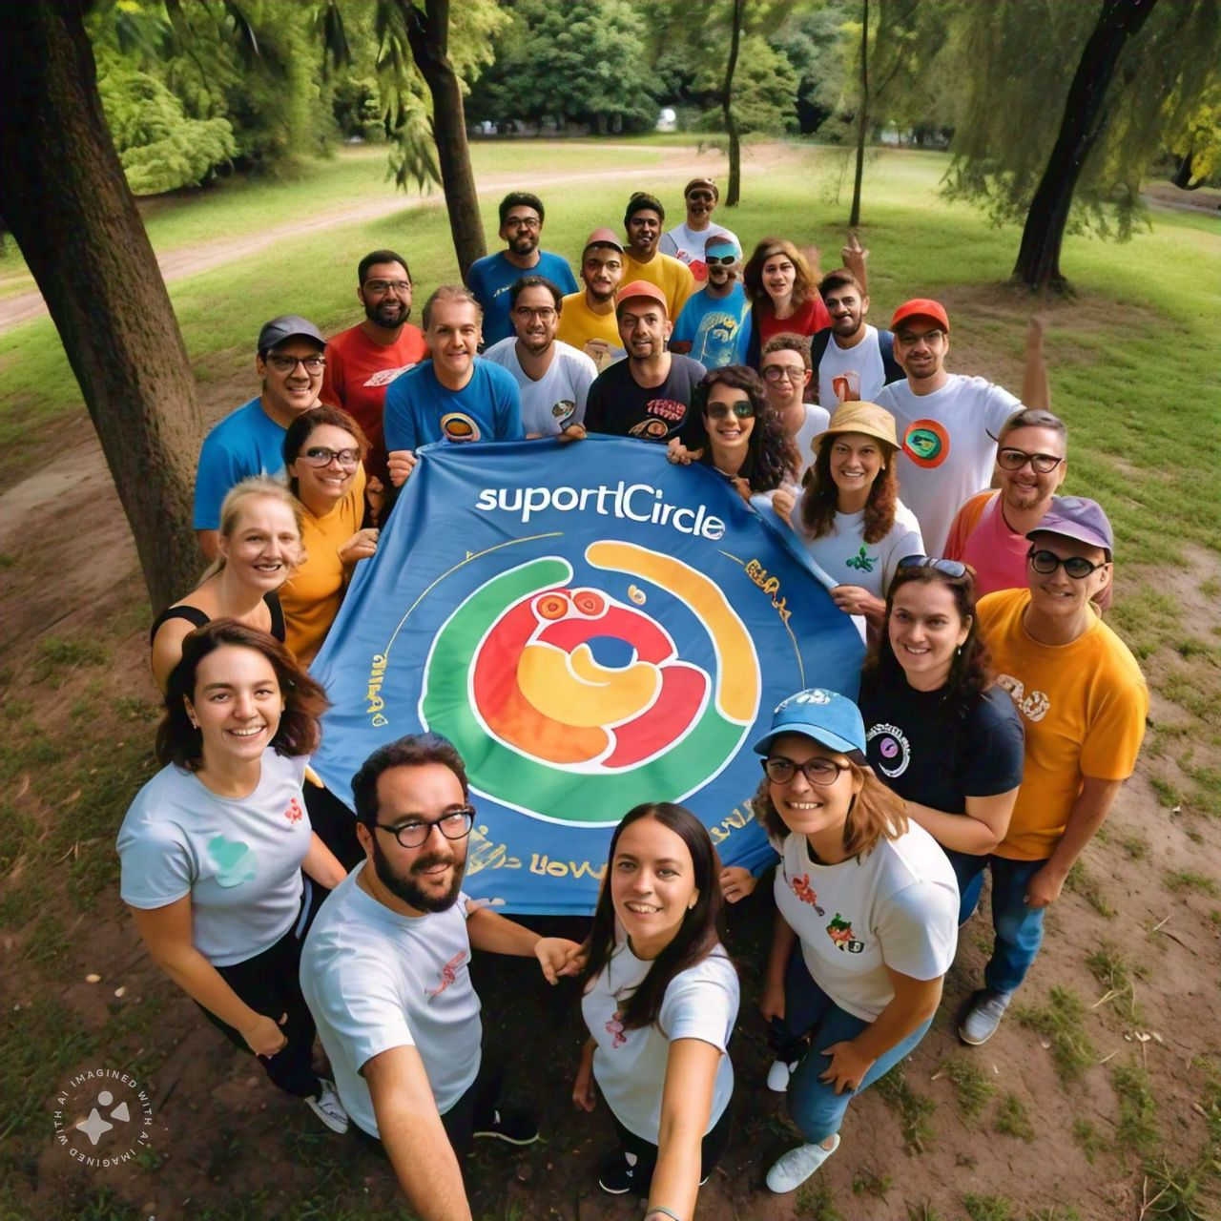

Introduction
Welcome to [SUPPORT CIRCLE] a dedicated platform committed to providing free educational resources for children supported by NGOs. Our mission is to empower underserved communities by offering high-quality learning materials, interactive courses, and support tailored specifically for the needs of NGO-sponsored children.
Join us in our mission to break down barriers to education and create a world where every child can thrive. Explore our website to find resources, connect with other NGOs, and contribute to our community-focused initiatives. Together, we can make a difference
Notes:
Font Styles: Times New Roman + Font Size: 25

Slide 4
Literature Review
Introduction:-"Support Circle" is an innovative online platform aimed at enhancing the effectiveness of non-governmental organizations (NGOs) by providing resources, volunteer opportunities, and community support.
The Role of Digital Platforms in NGO Support :- Digital platforms have revolutionized the way NGOs operate, significantly improving their outreach operational efficiency
Community Engagement and Collaboration:-Community engagement is crucial for the success of NGOs, and digital platforms play a significant role in fostering this engagement. Research by S. M. R. and P. S. (2017)
Impact on NGO Operations:-The integration of technology into NGO operations has led to improved efficiency and transparency
Notes:
Font Styles: Times New Roman + Font Size: 25

Slide 5
Literature Review (Contd.)
Challenges and Limitations
Despite the potential benefits of digital platforms, several challenges must be addressed. Warschauer (2003) highlights the digital divide, noting that not all NGOs have equal access to technology, particularly those operating in low-resource environments.
Conclusion
This literature review underscores the transformative potential of the "Support Circle" website project in supporting NGOs. By leveraging digital tools for fundraising, volunteer engagement, and community collaboration, "Support Circle" can significantly enhance the effectiveness of non-profit organizations
Notes:
Font Styles: Times New Roman + Font Size: 25

Slide 6
Objective of the Project
Enhance NGO Visibility: To create a platform that increases the visibility of NGO.
Facilitate Volunteer Engagement: To connect volunteers with NGOs by providing an accessible interface for individuals to find and engage in meaningful volunteer opportunities that match their skills and interests
Foster Community Engagement: To build a community of supporters, volunteers, and NGOs that encourages collaboration, feedback, and mutual support, strengthening social ties and engagement.
Address Challenges Faced by NGOs: To identify and provide solutions for common challenges faced by NGOs, such as sustainability, resource limitations, and technology access
Promote Awareness of Social Issues: To raise awareness about critical social issues addressed by NGOs, encouraging public involvement and support
Promote Awareness of Social Issues: To raise awareness about critical social issues addressed by NGOs, encouraging public involvement and support
Notes:
Font Styles: Times New Roman + Font Size: 25

Slide 7
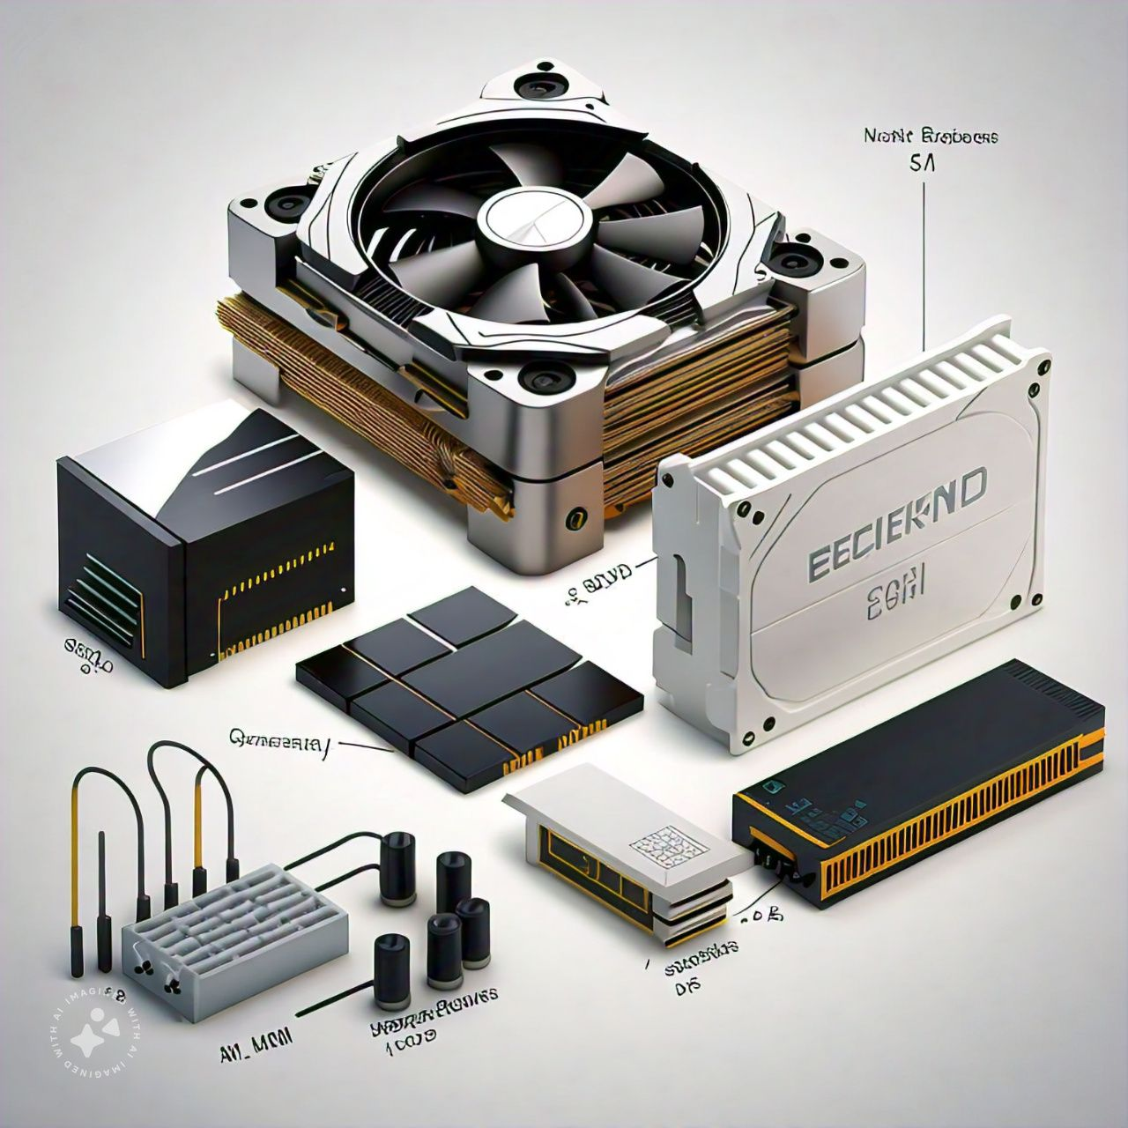
Technology (Hardware Requirements)
Processor (CPU)-: Multi core Processor(Intel Xeon or AMD EPYC for larger sites).
RAM-: Small sites 4GB RAM minimum.
STORAGE -: SSDs are preferred for faster data access.
Internet Connection -: High-speed connection with a static IP for consistent performance.
Network Bandwidth
Notes:
Font Styles: Times New Roman + Font Size: 25

Slide 8
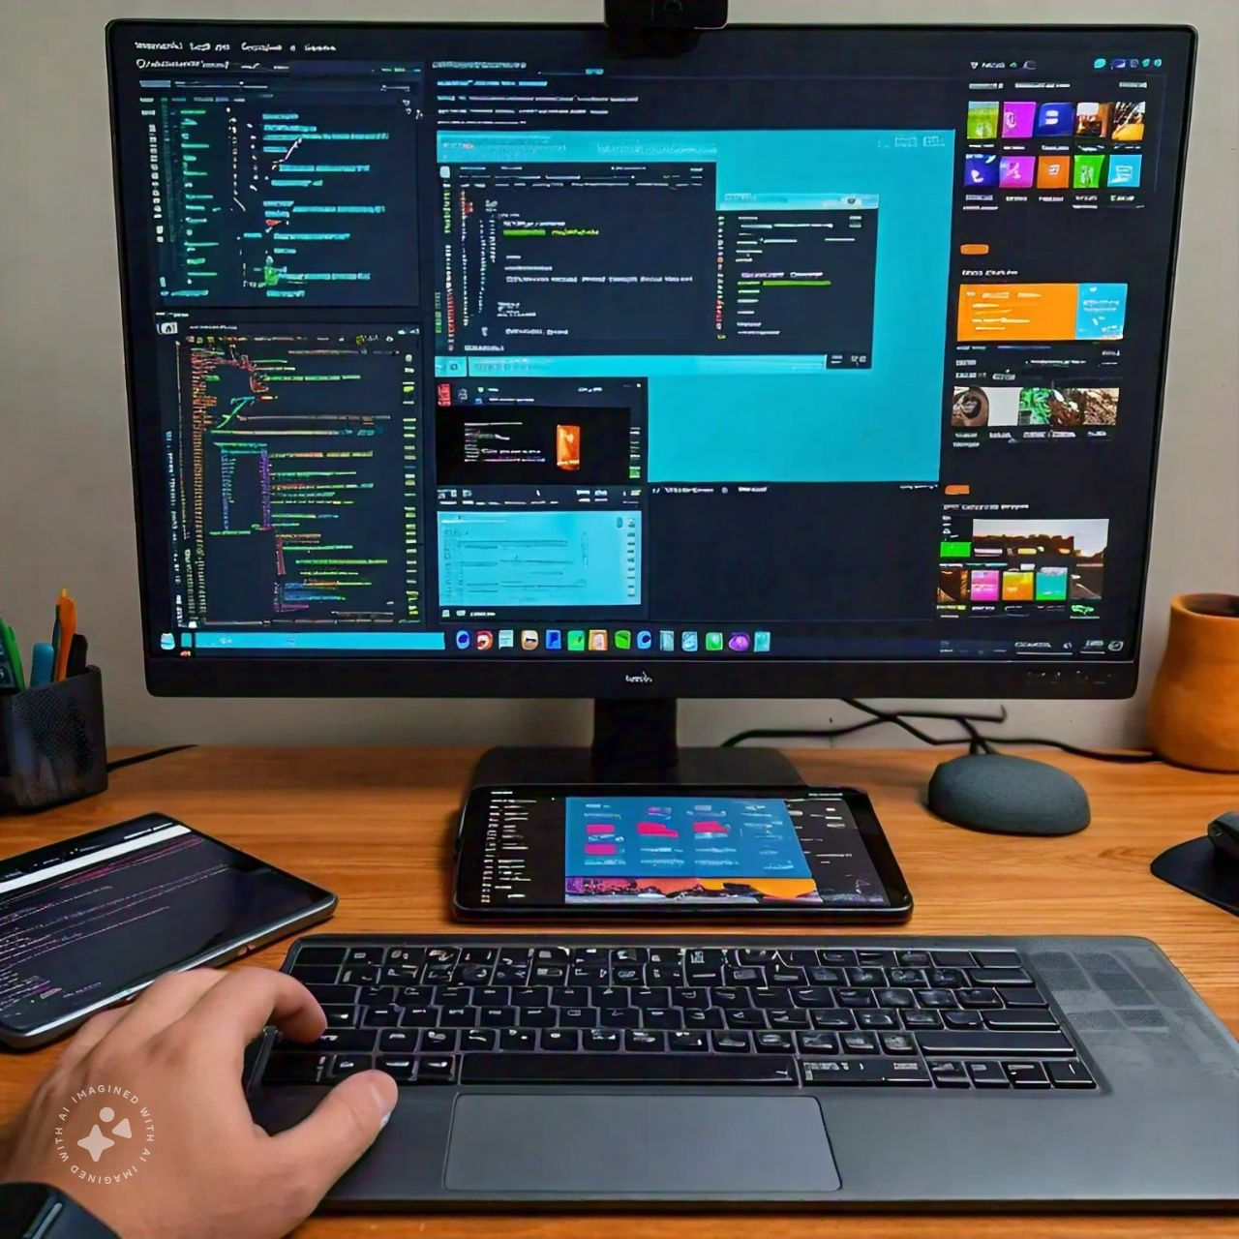
Technology (Software Requirements)
Language used: html,css,java,bootstrap,mern technology.
Database management (e.g., MySQL, PostgreSQL).
A hosting control panel (e.g., cPanel or Plesk) for managing the server.
Tools/Software:
Code editors like Visual Studio Code, Sublime Text, or Atom.
Web browsers for testing (Chrome, Firefox, etc.).
Local web servers (e.g., XAMPP, WAMP, MAMP for testing PHP-based sites).
Notes:
Font Styles: Times New Roman + Font Size: 25

Slide 9
Modules
Module 1: TEACHER REGISTRATION
Account Setup:- Helper create profiles, provide details about their professional, and area they belonging.
Time Sceduling-: Schedule their time by they will comfort.
Proficiency:- what they want to teach .
Notes:
Font Styles: Times New Roman + Font Size: 25

Slide 10
Modules (Contd.)
MODULE 2: RECIPIENT MANAGEMENT
Recipient Profiles:- NGO will create their valid profiles, content location and many more information about their NGOs capacity of holding.
Requirement of type help:- what type of help they want.
Faculity requirements:-what type of faculity they reqired for scheduled day
Notes:
Font Styles: Times New Roman + Font Size: 25

Slide 11
Modules (Contd.)
MODULE 3: DONER MANAGEMENT
Doner Profiles:- Doner will create their valid profiles.
Type Of Donation:- what they want to donate.
Notes:
Font Styles: Times New Roman + Font Size: 25

Slide 12
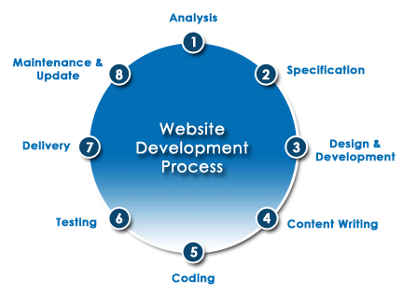
WORKFLOW
Notes:
Font Styles: Times New Roman + Font Size: 25

